Slide 1
Application of Information Theory

Slide 2
Applications in machine learning
Decision tree
Document Clustering
Some other stories
Homework

Slide 3
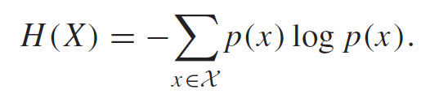
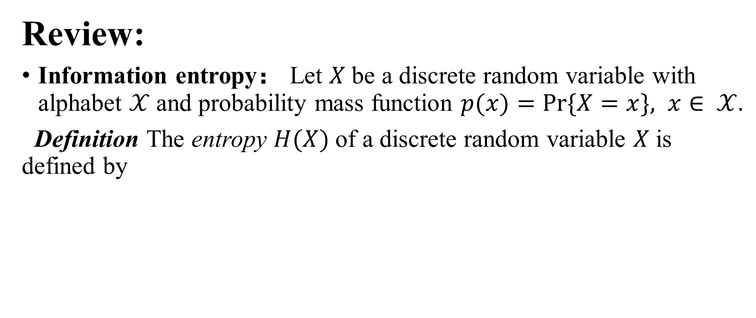
Review:
Information entropy： Let $X$be a discrete random variable with alphabet $𝒳$and probability mass function $p(x)=Pr⁡\{X=x\}, x∈ 𝒳.$
Definition The entropy $H(X)$of a discrete random variable $X$is defined by

Slide 4
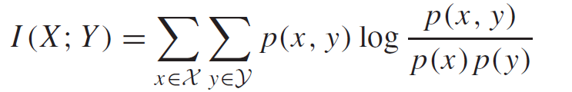
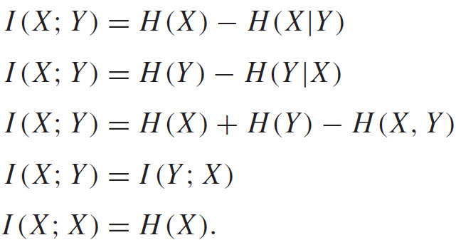

Mutual Information: Consider two random variables $X$and $Y$ with a joint probability mass function $p(x, y)$and marginal probability mass functions $p(x)$and $p(y).$Their mutual information $I(X;Y)$is
Theorem:

Slide 5
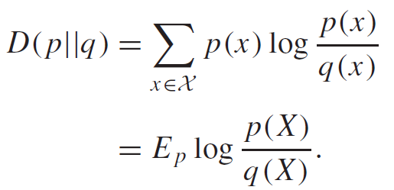

Relative entropy:
Definition The relative entropy or Kullback–Leibler distance between two probability mass functions $p(x)$and $q(x)$is defined as

Slide 6
Decision Tree

Slide 7
Decision Tree
What is the decision tree?
decision trees are constructed via an algorithmic approach that identifies ways to split a data set based on different conditions.
How does the decision tree work?
A decision tree is a tree-like graph with:
nodes representing the place where we pick an attribute and ask a question;
edges represent the answers to the question;
and the leaves represent the actual output or class label.

Slide 8
An example
Suppose we want to play on a particular day (like Saturday) –we need to decide whether we will go to play.
A general way is to check the outdoor temperature, humidity, weather and the speed of the wind.
We take all of these factors into account to make a decision.

Slide 9
We calculate all of these factors for ten days and form a lookup table as shown below.
Day | Weather | Temperature | Humidity | Wind | Play?
1 | Sunny | Hot | High | Weak | No
2 | Cloudy | Hot | High | Weak | Yes
3 | Sunny | Mild | Normal | Strong | Yes
4 | Cloudy | Mild | High | Strong | Yes
5 | Rainy | Mild | High | Strong | No
6 | Rainy | Cool | Normal | Strong | No
7 | Rainy | Mild | High | Weak | Yes
8 | Sunny | Hot | High | Strong | No
9 | Cloudy | Hot | Normal | Weak | Yes
10 | Rainy | Mild | High | Strong | No
Table 1.1 the decision in ten days with different factors

Slide 10
Now, we can use this table to make a decision.
However, we may encounter a question:
What should we do if the weather pattern on Saturday does not match with any of rows in the table?

Slide 11
A decision tree would be a great way to represent data like this because it takes into account all the possible paths that can lead to the final decision by following a tree-like structure.
The decision tree in this example may has the following structure
Weather=?
Sunny
Rainy
Cloudy
Humidity=?
Wind=?
Yes
High
Strong
Weak
Normal
Yes
No
Yes
No
Fig 1.1 a simple decision tree

Slide 12
From the above figure, we can see that:
each node represents an attribute or feature,
the branch of each node represents the values of that node.
Finally, the leaves of the tree is the final decision.

Slide 13
Question:
How to choose the factors in different layers. For example, which factor should be put on the root of the tree?
ID3 is an effective algorithm to deal with this question.

Slide 14
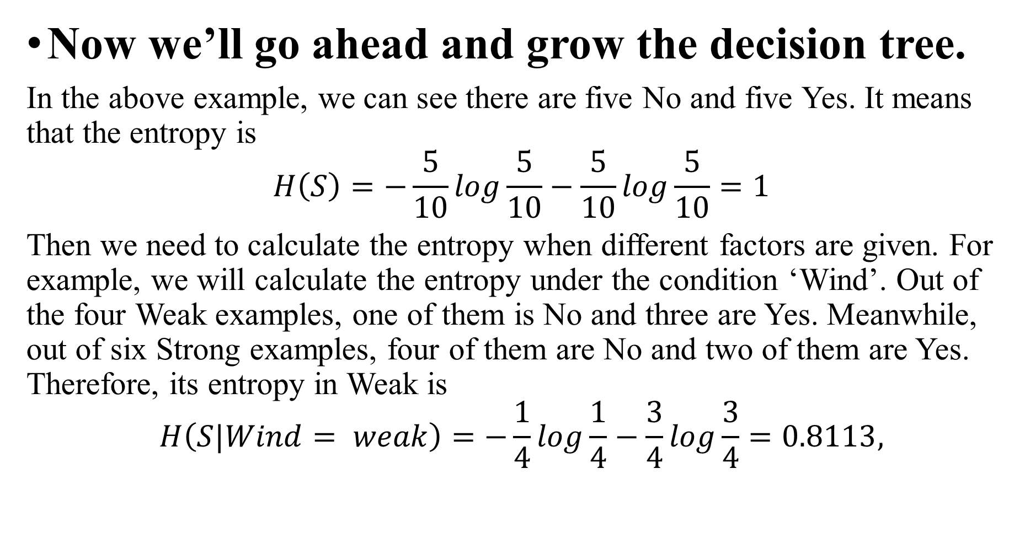
Now we’ll go ahead and grow the decision tree.
In the above example, we can see there are five No and five Yes. It means that the entropy is
$$H\left(S\right)=−\frac{5}{10}log\frac{5}{10}−\frac{5}{10}log\frac{5}{10}=1$$
Then we need to calculate the entropy when different factors are given. For example, we will calculate the entropy under the condition ‘Wind’. Out of the four Weak examples, one of them is No and three are Yes. Meanwhile, out of six Strong examples, four of them are No and two of them are Yes. Therefore, its entropy in Weak is
$$H\left(S|Wind= weak\right)=−\frac{1}{4}log\frac{1}{4}−\frac{3}{4}log\frac{3}{4}=0.8113,$$

Slide 15
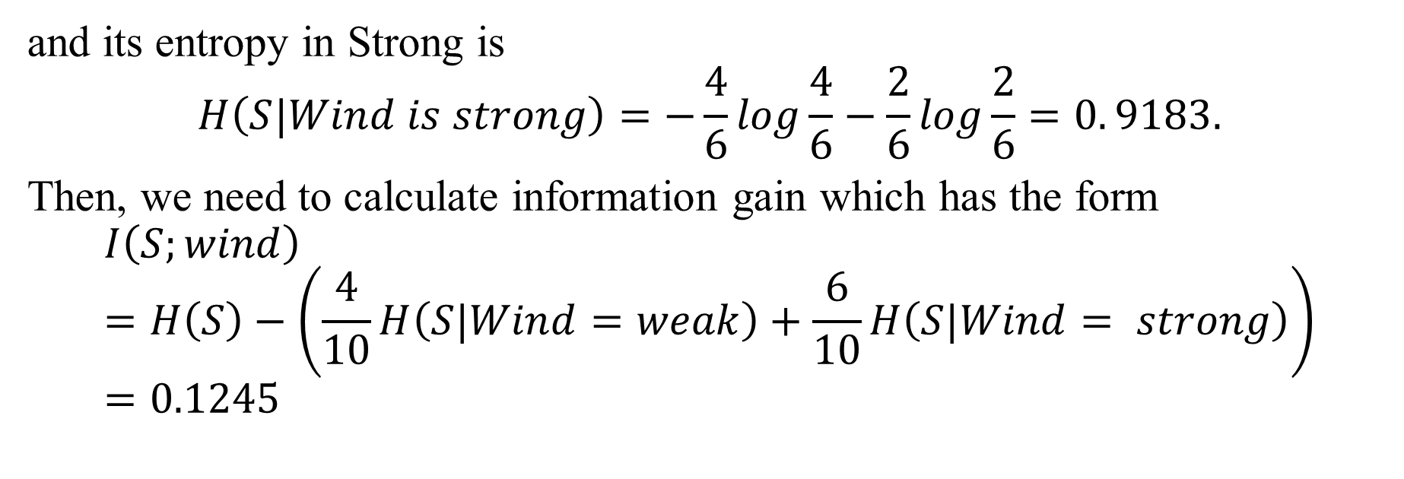
and its entropy in Strong is
$$H\left(S|Wind is strong\right)=−\frac{4}{6}log\frac{4}{6}−\frac{2}{6}log\frac{2}{6}=0. 9183.$$
Then, we need to calculate information gain which has the form
$$I\left(S;wind\right)=H\left(S\right)−\left(\frac{4}{10}H\left(S|Wind=weak\right)+\frac{6}{10}H\left(S|Wind= strong\right)\right)=0.1245$$

Slide 16
Similarly, it can be calculated that the information gain of all factors are:
Therefore, we choose the factor ‘weather’ as the root of the tree since it has the largest value among all factors.
Table 1.2 the information gains of different factors
Wind | I(S;wind)=0.1245
Temperature | I(S;temperature)=0.1145
Weather | I(S;weather)=0.4
Humidity | I(S;humidity)=0.035

Slide 17
The corresponding tree is denoted as:
For the subset ‘Cloudy’, it can be seen that all samples in it are Yes. Therefore, we do not need to divide it in the next step.
Then we further divide remaining subsets by calculating the entropies of other factors. As an example, let’s see the subset ‘Sunny’.
Weather=?
Sunny
Rainy
Cloudy
Yes
Fig 1.2 the root of the decision tree
Day | Weather | Temperature | Humidity | Wind | Play?
1 | Sunny | Hot | High | Weak | No
3 | Sunny | Mild | Normal | Strong | Yes
8 | Sunny | Hot | High | Strong | No
Table 1.3 the decision under ‘sunny’

Slide 18
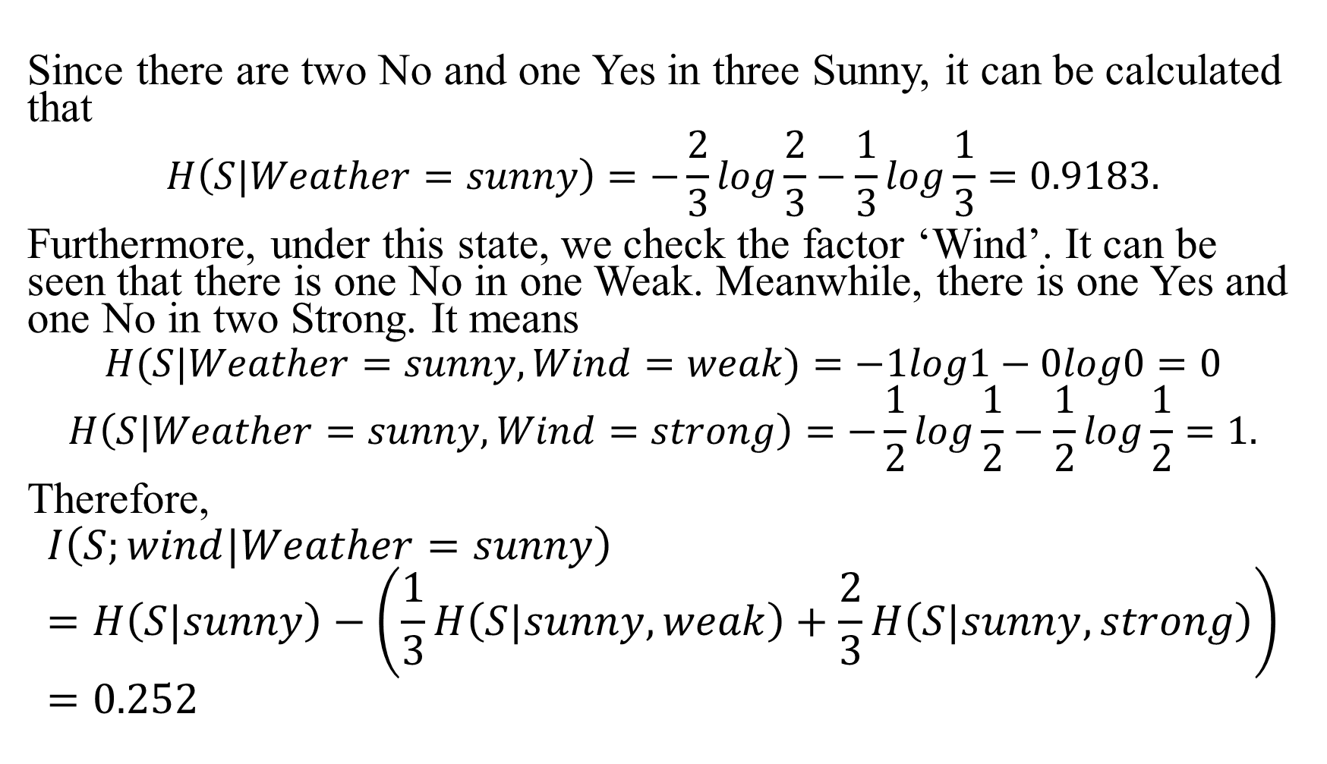
Since there are two No and one Yes in three Sunny, it can be calculated that
$$H\left(S|Weather=sunny\right)=−\frac{2}{3}log\frac{2}{3}−\frac{1}{3}log\frac{1}{3}=0.9183.$$
Furthermore, under this state, we check the factor ‘Wind’. It can be seen that there is one No in one Weak. Meanwhile, there is one Yes and one No in two Strong. It means
$$H(S|Weather=sunny,Wind=weak)=−1log1−0log0=0$$
$$H\left(S|Weather=sunny,Wind=strong\right)=−\frac{1}{2}log\frac{1}{2}−\frac{1}{2}log\frac{1}{2}=1.$$
Therefore,
$$I\left(S;wind|Weather=sunny\right)=H\left(S|sunny\right)−\left(\frac{1}{3}H\left(S|sunny,weak\right)+\frac{2}{3}H\left(S|sunny,strong\right)\right)=0.252$$

Slide 19
Similarly, it can be obtained that
It can be observed that the values of ‘Temperature’ and ‘Humidity’ are the same. Therefore, we can choose one of them randomly.
Wind | I(S;wind|sunny)=0.252
Temperature | I(S;temperature|sunny)=0.918
Humidity | I(S;humidity|sunny)=0.918
Table 1.4 the information gains of different factors under ‘sunny’

Slide 20
The final decision tree is
According to the decision tree, if the Saturday is cloudy, we will go to play. Additionally, if the day is rainy but the wind is weak, we will go too.
Weather=?
Sunny
Rainy
Cloudy
Humidity=?
Wind=?
Yes
High
Strong
Weak
Normal
Yes
No
Yes
No
Fig 1.3 the final decision tree

Slide 21
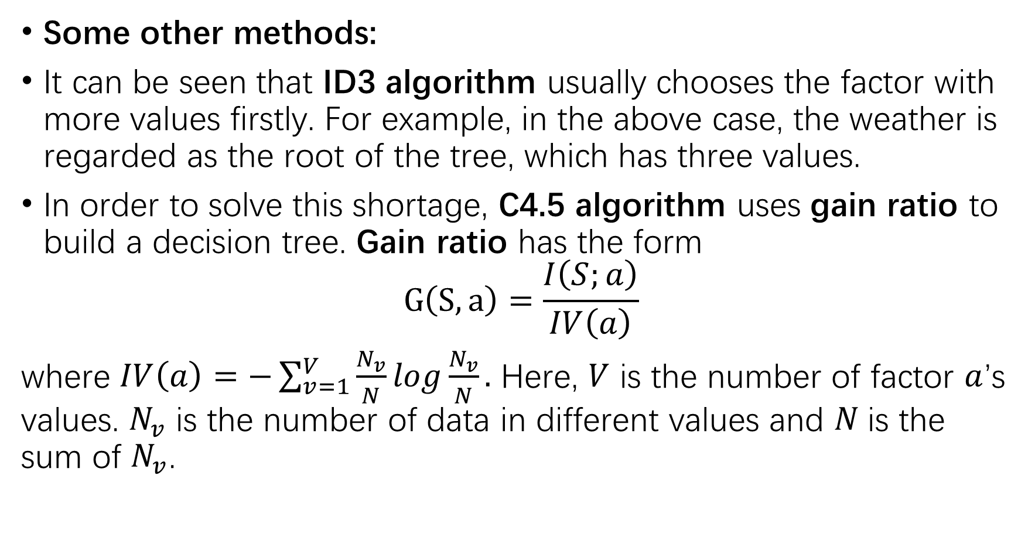
Some other methods:
It can be seen that ID3 algorithm usually chooses the factor with more values firstly. For example, in the above case, the weather is regarded as the root of the tree, which has three values.
In order to solve this shortage, C4.5 algorithm uses gain ratio to build a decision tree. Gain ratio has the form
$$G\left(S,a\right)=\frac{I\left(S;a\right)}{IV\left(a\right)}$$
where $IV\left(a\right)=−\sum_{v=1}^{V}{\frac{N_{v}}{N}log\frac{N_{v}}{N}}.$ Here, $V$ is the number of factor $a$’s values. $N_{v}$ is the number of data in different values and $N$is the sum of $N_{v}$.

Slide 22
As shown in the above case, the data set only has four factors. In many practical cases, we need to build a decision tree by considering a lot of factors, which make the decision tree too large. Therefore, pruning is necessary in many cases.
Generally, pruning can be divided into pre-pruning and post-pruning. You can read some other references for the details.
Note that the factors we considered above are discrete. For the factors with the continuous value, we can use discretization technology, see C4.5 algorithm.

Slide 23
Document Clustering

Slide 24
In natural language processing, one of the most important tasks is Document Clustering, i.e., organizing a large quantity of unordered documents into a small number of meaningful and coherent clusters.
How to achieve this goal effectively?

Slide 25
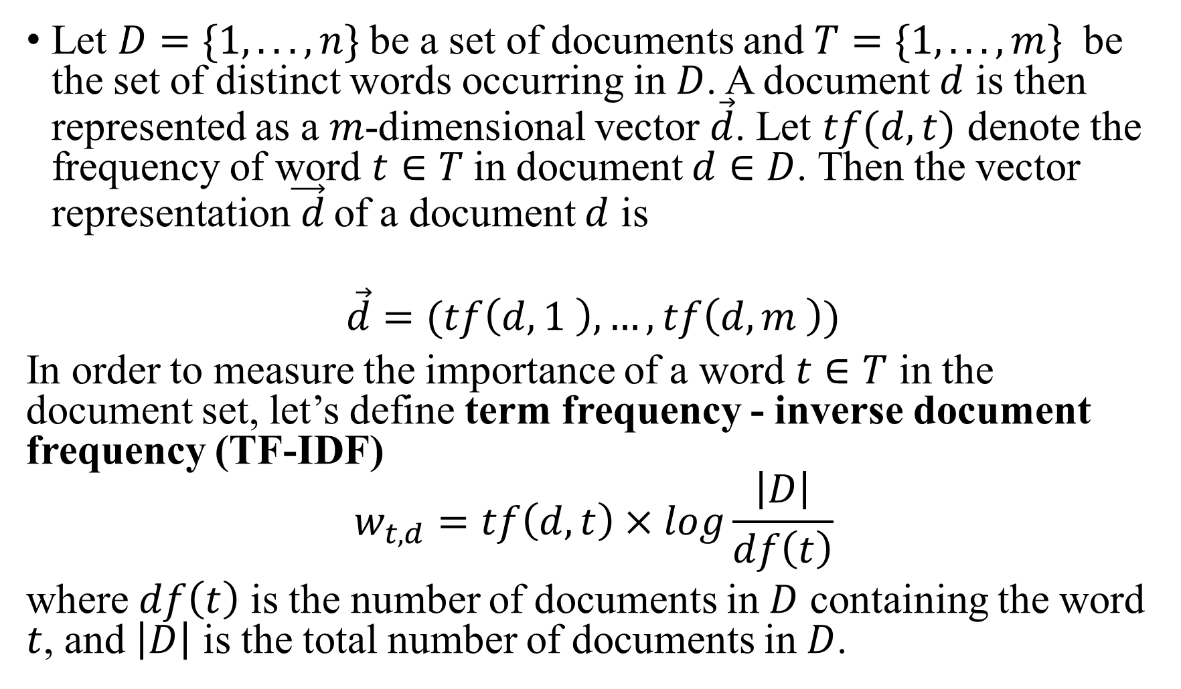
Let $D=\{1, . . . ,n\}$be a set of documents and $T=\{1, . . . ,m\}$ be the set of distinct words occurring in $D$. A document $d$ is then represented as a $m$-dimensional vector $\vec{d}$. Let $tf(d,t)$ denote the frequency of word $t∈T$in document $d∈D$. Then the vector representation$\vec{ d}$ of a document $d$ is
$$\vec{d}=(tf\left(d,1 \right),…,tf\left(d,m \right))$$
In order to measure the importance of a word $t∈T$ in the document set, let’s define term frequency - inverse document frequency (TF-IDF)
$$w_{t,d}=tf\left(d,t\right)×log\frac{\left|D\right|}{df\left(t\right)}$$
where $df\left(t\right)$ is the number of documents in $D$ containing the word $t$, and $\left|D\right|$ is the total number of documents in $D$.

Slide 26
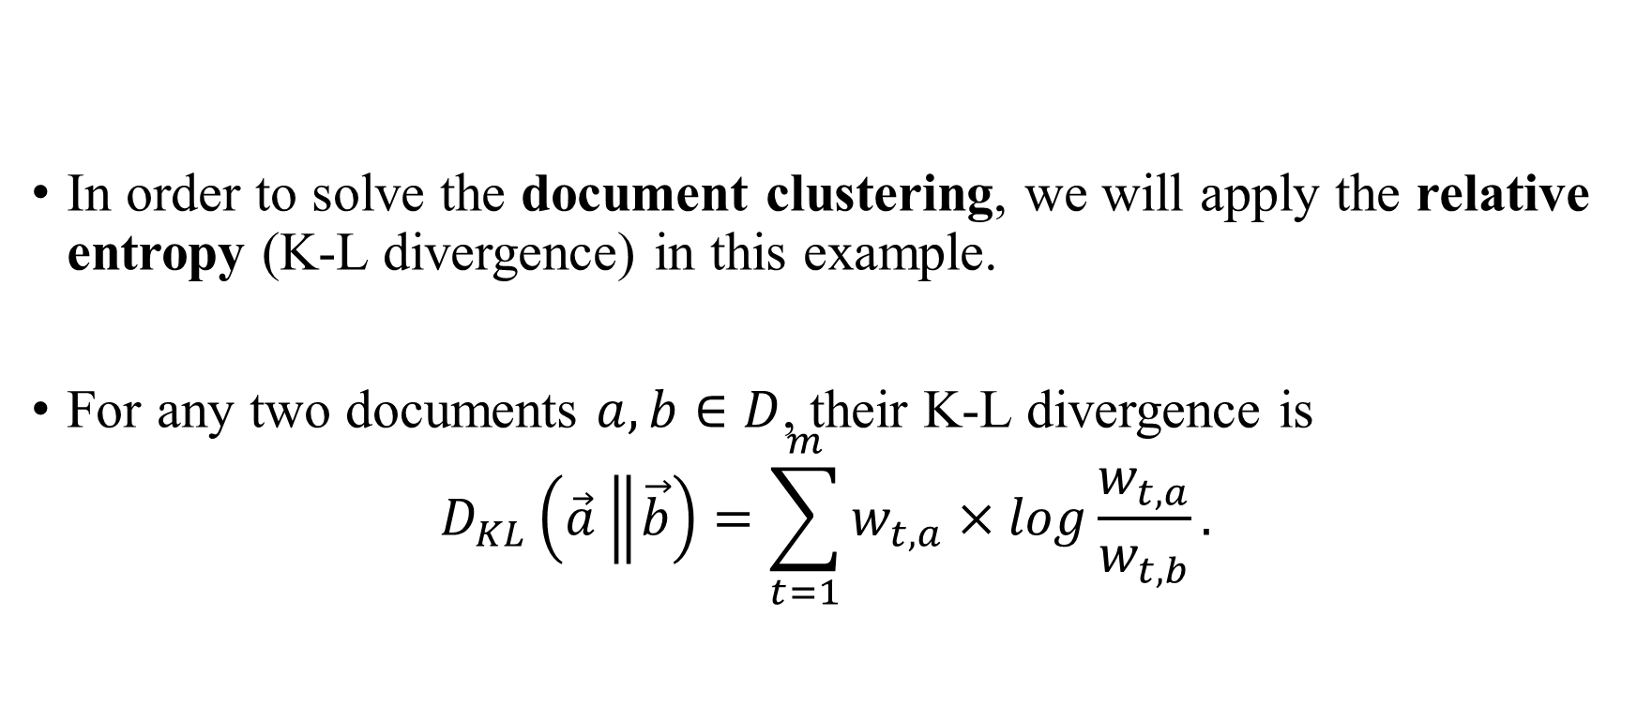
In order to solve the document clustering, we will apply the relative entropy (K-L divergence) in this example.
For any two documents $a,b∈D$, their K-L divergence is
$$D_{KL}\left(\vec{a}\left\|\vec{b}\right.\right)=\sum_{t=1}^{m}{w_{t,a}×log\frac{w_{t,a}}{w_{t,b}}.}$$

Slide 27
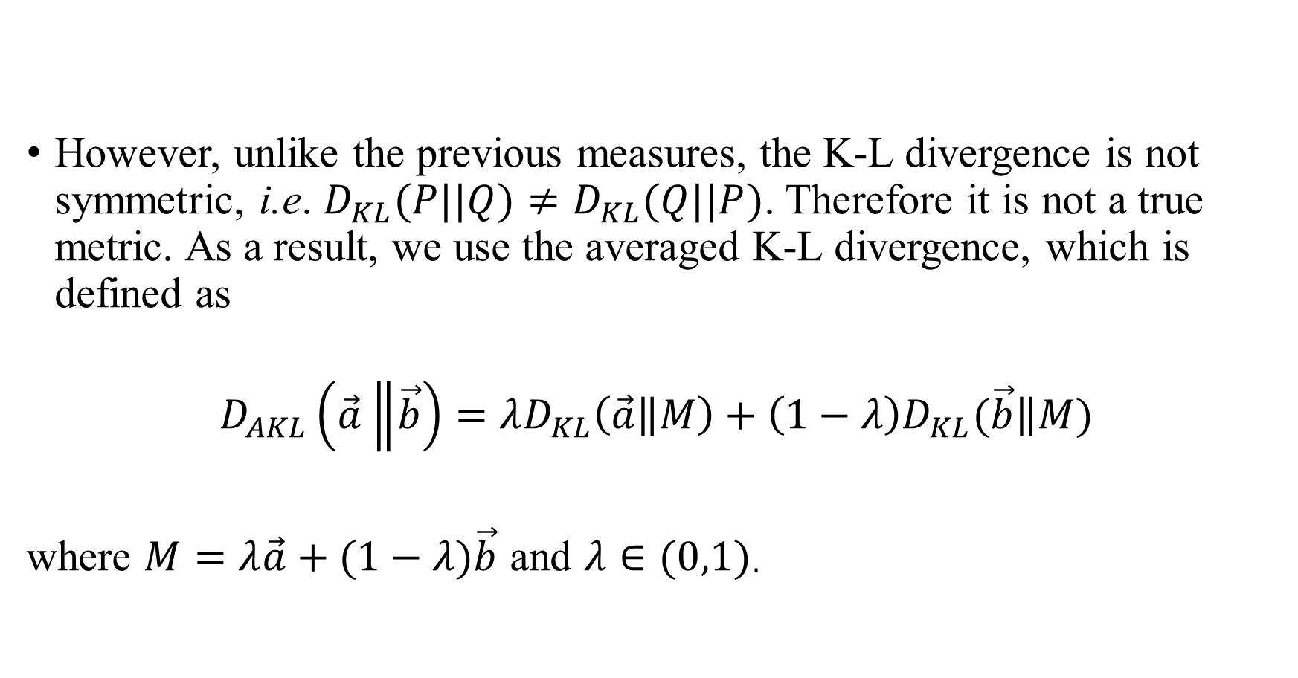
However, unlike the previous measures, the K-L divergence is not symmetric, i.e. $D_{KL}(P||Q)≠D_{KL}(Q||P)$. Therefore it is not a true metric. As a result, we use the averaged K-L divergence, which is defined as
$$D_{AKL}\left(\vec{a}\left\|\vec{b}\right.\right)=λD_{KL}\left(\vec{a}\left\|M\right.\right)+\left(1−λ\right)D_{KL}(\vec{b}\left\|M\right.)$$
where $M=λ\vec{a}+(1−λ)\vec{b}$ and $λ∈(0,1)$.

Slide 28
To evaluate this method, we apply it to article clustering where the data set is obtained from CLUTO package. In particular, the data set has 19930 articles, whose topics include politics, computers, finances, sports.
The final results is shown in the following table.
Table 2.1 data set
Politics | Computers | Finances | Sports
4432 | 6821 | 5424 | 3253
Class | Politics | Computers | Finances | Sports
Article quantity | 4432 | 6821 | 5424 | 3253
Quantity of correct articles | 2357 | 2933 | 3525 | 1171
accuracy | 0.53 | 0.43 | 0.65 | 0.36
Table 2.2 experiment results for different classes of articles

Slide 29
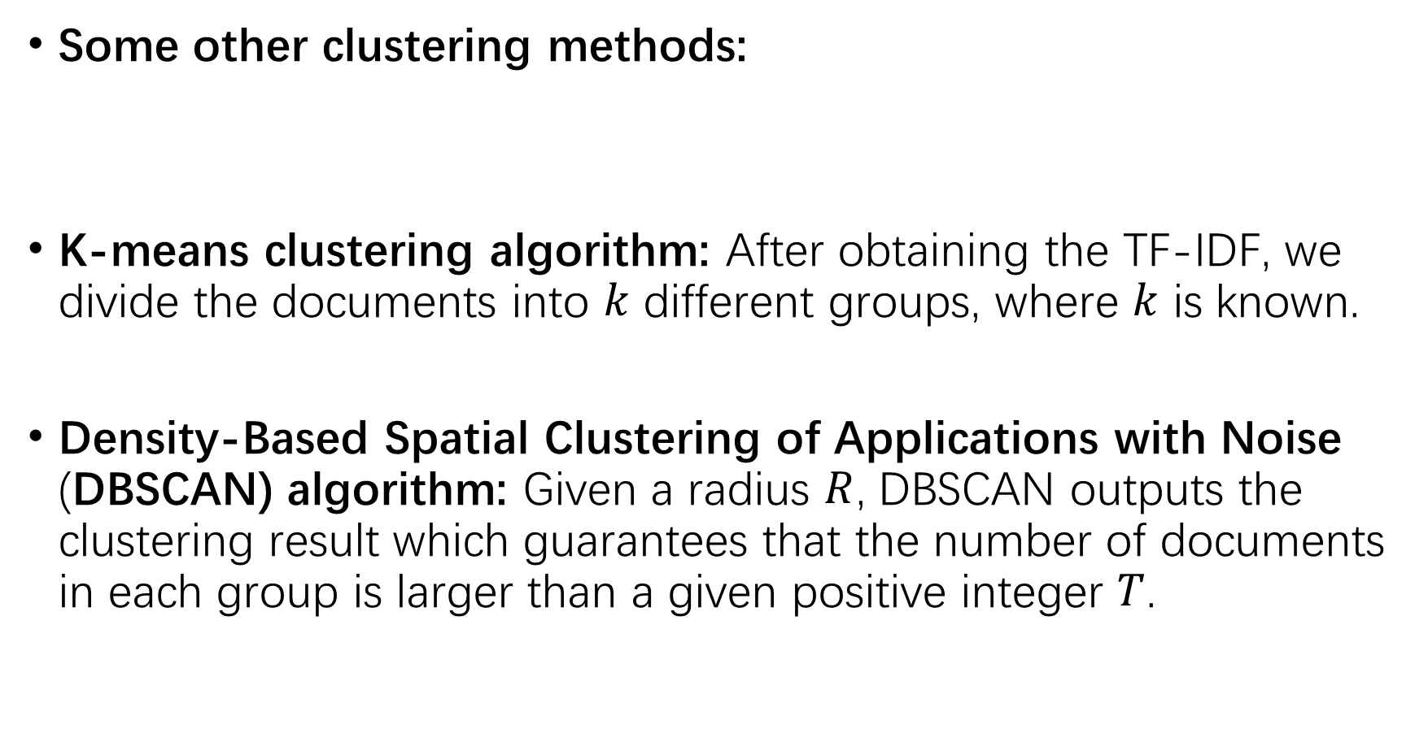
Some other clustering methods:
K-means clustering algorithm: After obtaining the TF-IDF, we divide the documents into $k$ different groups, where $k$ is known.
Density-Based Spatial Clustering of Applications with Noise (DBSCAN) algorithm: Given a radius $R$, DBSCAN outputs the clustering result which guarantees that the number of documents in each group is larger than a given positive integer $T$.

Slide 30
Some other stories

Slide 31
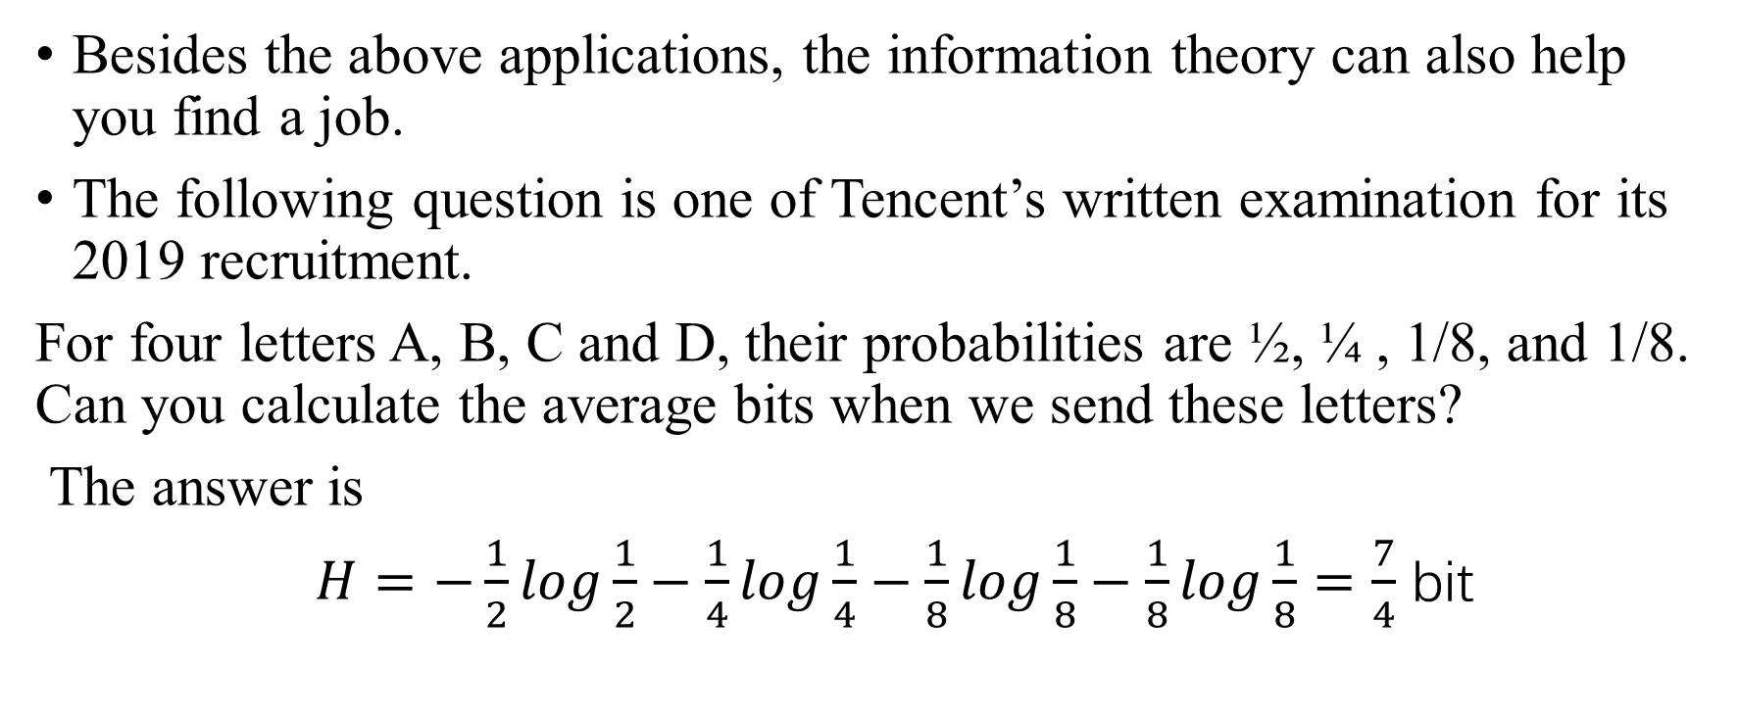
Besides the above applications, the information theory can also help you find a job.
The following question is one of Tencent’s written examination for its 2019 recruitment.
For four letters A, B, C and D, their probabilities are ½, ¼ , 1/8, and 1/8. Can you calculate the average bits when we send these letters?
The answer is
$H=−\frac{1}{2}log\frac{1}{2}−\frac{1}{4}log\frac{1}{4}−\frac{1}{8}log\frac{1}{8}−\frac{1}{8}log\frac{1}{8}=\frac{7}{4}$ bit

Slide 32
Homework:
Age | Income | Region | Credit rating | Buy motorbike?
<20 | High | USA | Low | No
<20 | High | USA | Low | No
21…50 | High | USA | Low | Yes
>50 | Medium | USA | Low | Yes
>50 | Low | CHINA | Low | Yes
>50 | Low | CHINA | High | No
21…50 | Low | CHINA | High | Yes
<20 | Medium | USA | Low | No
<20 | Low | CHINA | Low | Yes
>50 | Medium | CHINA | Low | Yes
<20 | Medium | CHINA | High | Yes
21…50 | Medium | USA | High | Yes
21…50 | High | CHINA | Low | Yes
>50 | Medium | USA | High | No
Table 0.1 data set of some consumers

Slide 33
According to Table 0.1, please construct a decision tree.
Bob does not know whether he should buy a motorbike with the following personal data. Can you help him to make a decision?
Age | Income | Region | Buy motorbike?
22 | High | USA | ?
Table 0.2 personal data of Bob

Slide 34
Thank you

